Slide 1
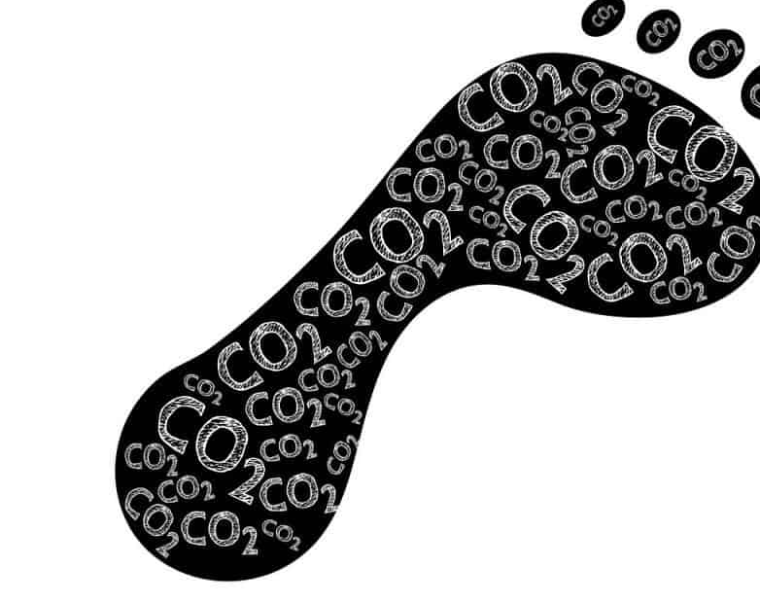

My Carbon Footprint

Slide 2
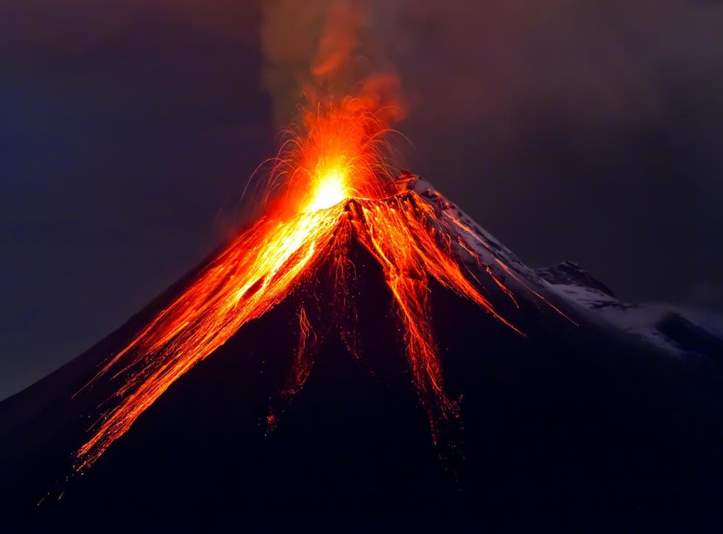
Climate change happens for a number of reasons. It can be caused by natural forces such as volcanic eruptions, the earth’s axis changing its tilt, & the suns rays brightening or lessening.

Slide 3
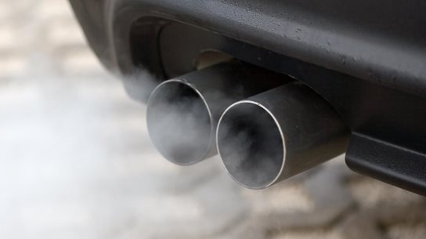
The main cause of climate change is human activity, through the burning fossil fuels to make electricity & power cars, it is also caused by cutting down forests and farming livestock.
The average temperature of our planet, the earth, is getting hotter. It’s causing the Arctic sea ice to melt which is raising sea levels, it’s causing more wildfires to burn throughout the world including in the United Kingdom.

Slide 4
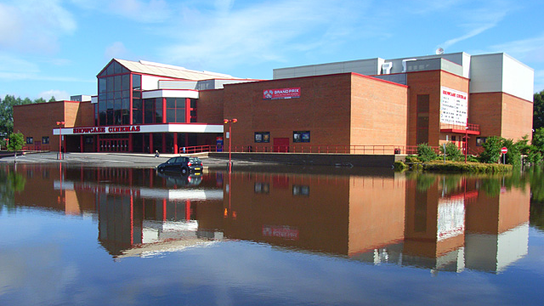
Climate Change
In Wokingham climate change makes flooding more likely to happen. It also makes heatwaves more likely.

Slide 5
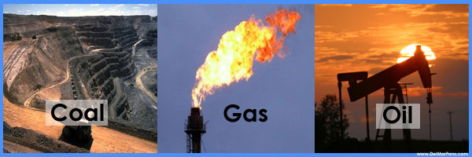

Wait Fossil Fuels…What are they?
Fossil fuels are made from plants and creatures that have died and over millions of years have been squashed tightly together and as a result contain a lot of energy.
They have become buried deep underground under layers of earth and rock.
Fossil fuels can come in the form of a solid Coal, a liquid, Oil or a gas, Natural Gas.
Over the past 150 years humans have been digging them up to burn and turn into energy.
Take five minutes to discuss and write down some examples of everyday things we do that result in burning fossil fuels.

Slide 6

Fossil Fuels Produce Greenhouse Gases
Every time we use a car the petrol, which is made from oil is burned and creates a greenhouse gas. One of the gases that comes from a car’s exhaust is called carbon dioxide.
When we turn the thermostat up in our house some of the energy comes from natural gas being burned in a power station which releases methane, another green house gas.
When you spend time in front of a screen, you are using fossil fuels as the energy that charges the battery of an I-pad or a phone, some of that energy comes from the burning of fossil fuels.

Slide 7
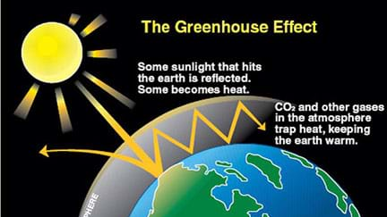

Slide 8
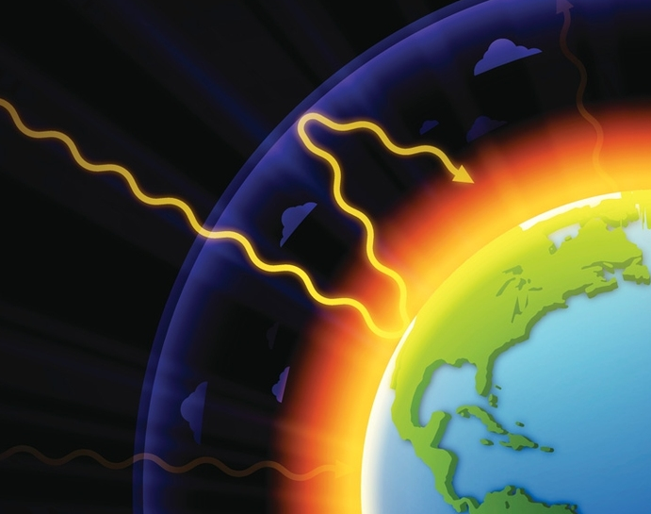
Greenhouse Gases
The release of carbon dioxide and methane gas through energy use causes an increase in greenhouse gases in the atmosphere.
It is caused by the sunrays entering the atmosphere and the heat from the rays being trapped by carbon dioxide & methane.
We need some greenhouse gases to keep the earth warm, but we have upset the balance the average temperature of our planet is rising.

Slide 9
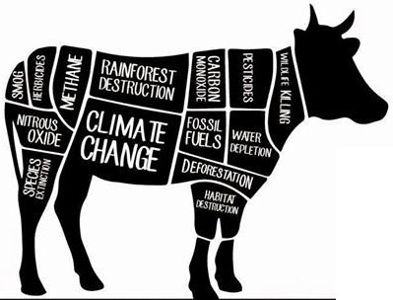
Farming & Greenhouse gases
Farming is another way greenhouse gases are added to the atmosphere.
Cows & sheep produce methane which is released into the air.
The land needed to produce cows, sheep and pigs is far greater than the land needed to grow plant proteins which in turn prevents more land being used for planting forests that would draw in and store carbon dioxide.
Swapping you’re protein to a plant based alternative can help you reduce your carbon footprint. If you help with the shopping take a look at the vegetarian meats that are available.

Slide 10

What can I do to reduce my Carbon Footprint?
There are three big things that you can do that can reduce your carbon footprint.
When you can choose to eat vegetarian and vegan meals.
Choose to holiday in the UK and avoid flying.
Choose active travel and walk, cycle or use public transport when you travel locally.
Some of these decisions will be made by your family but talking to your family about carbon footprints can help us all reduce our carbon pollution.

Slide 11

Activity
Part 1 -Think about your life and the things you do that may create a carbon footprint. Draw an open footprint and sketch the activities you that contribute to your carbon footprint.
Part 2 -Then think about choices that you can make to reduce your carbon footprint. Write down three pledges that you think you can a make and talk about your pledges with your neighbour.

