Slide 1


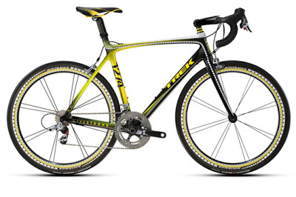


Travelling to School
Every Journey Counts

Slide 2
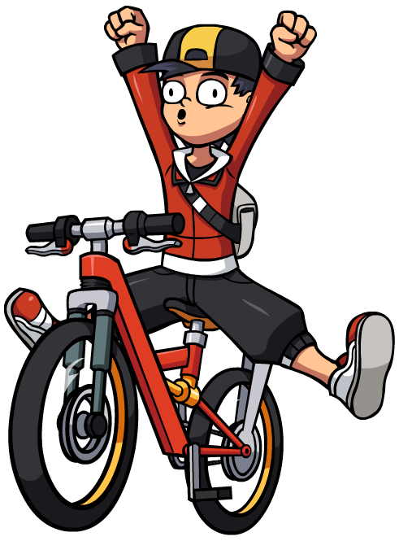
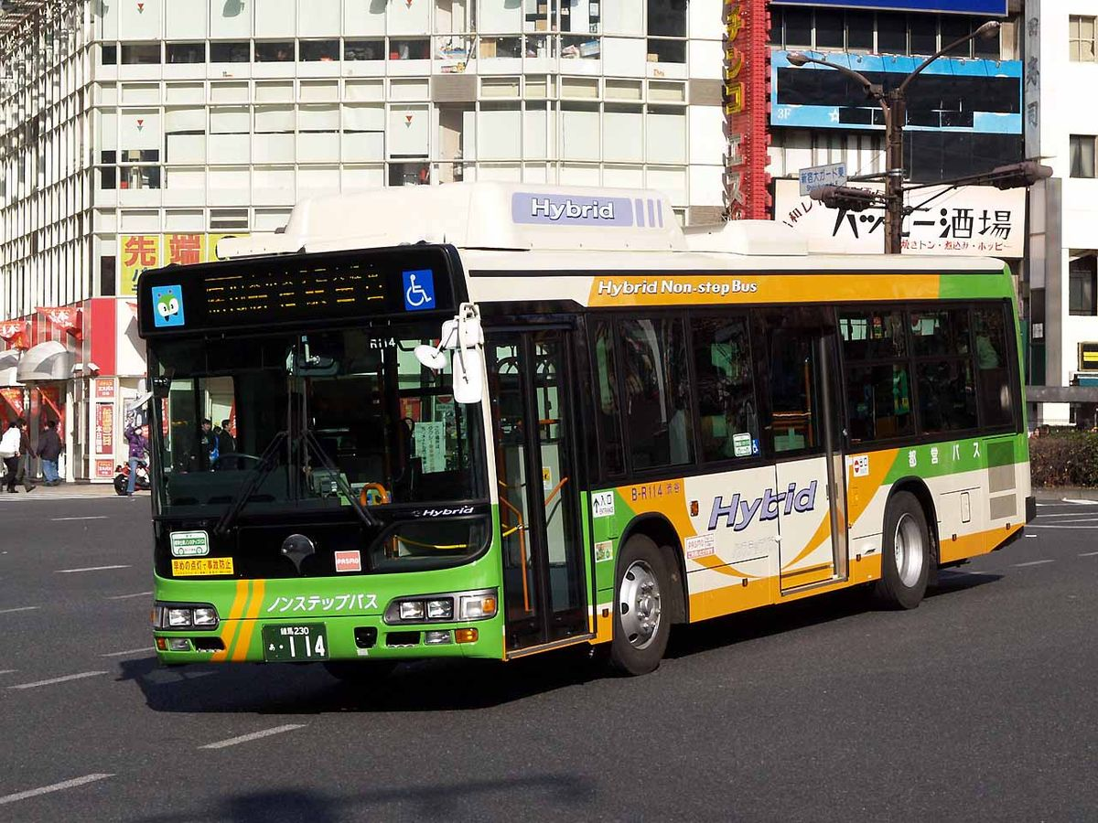
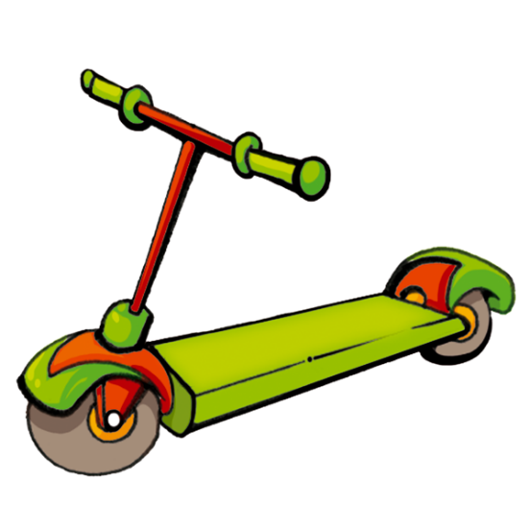


How Do You usually Travel to School?

Slide 3


What do we mean by sustainable travel?
Sustainable travel means that you use a type of transport that does not involve using fossil fuels or adding to congestion.
This could be:
  Walking
  Cycling
  Scooting
Other types of transport that are not as sustainable, but still can be helpful in cutting pollution and congestion include:
  Public transport
  Park and Stride / cycle
Notes:
You might like to pause the assembly here so that pupils can consider their answer

Slide 4






WHy IS IT GOOD TO WALK, CYCLE OR SCOOT TO SCHOOL?

Slide 5


How many people at your school travelled by each type of transport?
What do you think this means for congestion, pollution and health?
This Photo by Unknown Author is licensed under CC BY-SA
Notes:
You could pause the assembly here to include a discussion about this topic.

Slide 6
Did you know?

Slide 7




How does your school compare to others in Wokingham Borough?

Slide 8
What makes walking, cycling or scooting to school more difficult?
I live too far away
My mum or dad has to go to work
I have a brother or sister at a different school
Busy roads
Nowhere to cross the road
Notes:
Again, you could pause the assembly here to include a discussion about the barriers to sustainable travel. What other things do pupils think make walking, cycling or scooting more difficult?

Slide 9
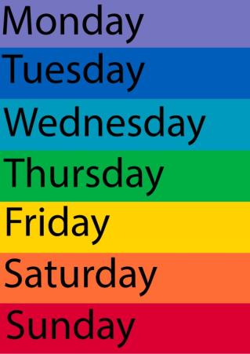
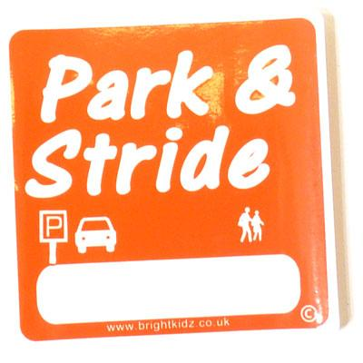
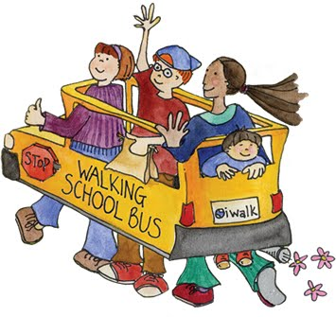
How can we walk / cycle or scoot more?

Slide 10
What is a park and stride / walking bus / cycle train?
A place is found near the school where parents can park and the children can walk or cycle to school together.
A park and stride / cycle is where you walk or cycle to school with your own parents.
A walking bus or cycle train are where volunteers will walk or cycle with you.

Slide 11



What other ways can encourage walking, cycling and scooting to school?
Notes:
You could pause the assembly here to include a discussion about other ways to encourage sustainable travel.

Slide 12


Slide 13
Assembly Activity
  Think about these questions:
  How do you usually travel to school?
  Why might you travel in this way?
  What are some good things about how you travel to school?
  What things do you not like about the way you travel?
  What is sustainable travel?
  How much physical activity do you think you need each day to stay healthy?
  Name ways that you can travel sustainably more often?
Notes:
Some ideas for discussion points that pupils can do in groups or individually. If pupils are watching this from home, they could write their answers.

