Slide 1
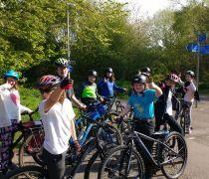
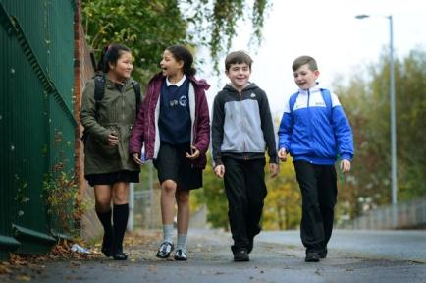
YEAR 6 TRANSITION
INDEPENDENT TRAVEL TO SECONDARY SCHOOL

Slide 2
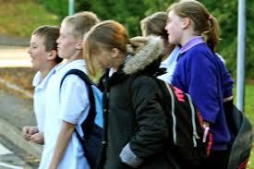
As you get older you are likely to be given more and more freedom.
Having more freedom may seem great but it also means you have to take on more responsibility.

Slide 3
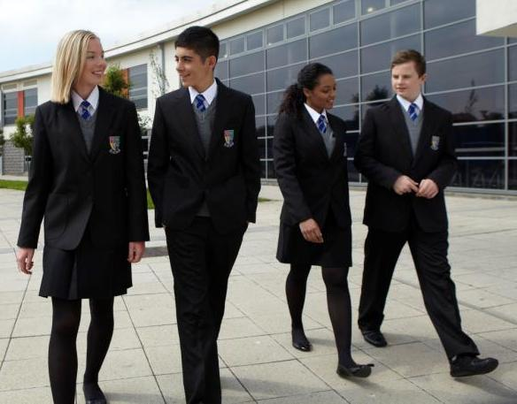
In September you will be starting secondary school and leaving behind all that is familiar to you at your primary school.

Slide 4

For a lot of you getting to your new school will bring a big change.

Slide 5
Travel further
Use Public Transport
Walk alone
Cycle alone

Slide 6
An 11-year-old starting secondary school is
almost twice as likely
as a 10-year-old at primary school
to be killed or seriously injured
in road collisions (more boys).
Statistics from the Department of Transport

Slide 7
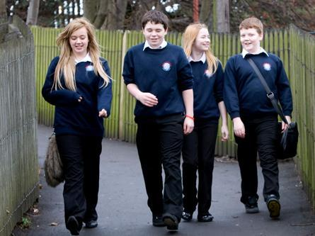
Just from Wokingham Borough’s
Secondary Schools
9,000
pupils travel to school each day

Slide 8


The percentage of casualties involving 10-14 year olds
just on a journey to or from school

Slide 9
Think about
getting to school...

Slide 10
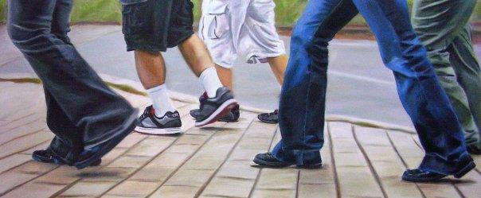
What is the normal travelling speed of a person walking?
3 mph

Slide 11
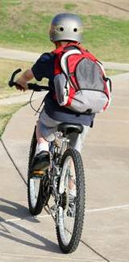
What is the travelling speed of a person cycling?
8 - 10 mph

Slide 12
What is the travelling speed of a car?
5 – 80+ mph

Slide 13
As pedestrians we need to know two facts:
1. The faster a vehicle is going
the harder it will hit you
if you are involved in a
collision with it.

Slide 14
As pedestrians we need to know two facts:
2. The faster a vehicle is
going the more time
it will take to stop.

Slide 15

What is stopping distance?
Stopping distance is the distance a vehicle travels from the time the driver decides to stop until it comes to a halt.

Slide 16
Imagine a child runs out in front of a car what sequence of events has to happen before the car stops?
Thinking and braking

Slide 17
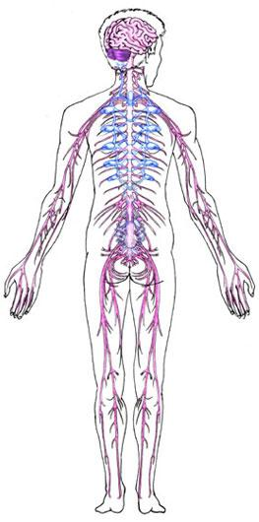
Signal to Eyes
Eyes to Brain
Brain to Foot
Foot to Brake pedal
Thinking and reacting
does not
happen instantly

Slide 18
Imagine a vehicle travelling at
20 MPH.
How far in metres will it take to stop?
12

Slide 19
Imagine a vehicle travelling at
30 MPH.
How far in metres will it take to stop?
23

Slide 20
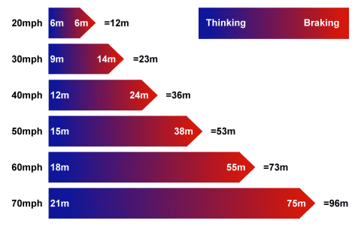

Slide 21

If you were hit by a vehicle travelling at 30mph you have an 80% chance of surviving.
If you were hit by a vehicle travelling at 40mph you have an 80% chance of dying.

Slide 22
So remember whether you are walking or riding your bike, vehicles (including bicycles) can not stop instantly.

Slide 23
Journey Planning –
how are you going to travel?
Print map – walking and cycle routes on My Journey website and journey planner to plan route from home to school
Bikeability training? Practise route in summer holidays with parents/friends and unaccompanied – how long will it take?
- which route is safest?
Always use safe crossings where available – zebra crossings, puffin and toucan traffic light crossings for pedestrians,
subways, footbridges, islands in the middle of the road, police officers can help too
Places where not safe to cross? – behind bus, between parked cars, brow of a hill, junctions, sharp corners –
even safe crossings can be dangerous (red light running and driver distractions) – don’t step out til vehicles STOPPED
What if friends want to take short cut across busy road with no pedestrian crossings? – DO NOT FOLLOW
Check timetables for public transport – live bus map on My Journey website - allow enough time to walk to stop
Look after each other!!

Slide 24
What can you do to prevent becoming a road traffic casualty statistic?
Plan ahead and
use proper crossing places
correctly

Slide 25
In built up areas 1 out of 5 pedestrian casualties are injured on or near to a crossing

Slide 26
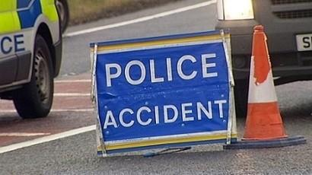
In a year almost 2,150 children aged 12–16 are hurt in road incidents because they did not look properly before crossing the road.
55% of casualties happen on the school run!

Slide 27
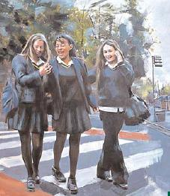

Talking and messing about with friends,
texting, messaging, chatting, playing games on a phone and listening to music are all distractions that make pedestrians less safe.

Slide 28

All you have to do is ...
and plan ahead.

