Slide 1
Roads away from home
Ages
3-6
Use these series of photos to explore different locations and how the road features may differ from the ones children may be used to.
Notes:
Teacher note: The slides are animated, so that the title of each different feature appears after the initial image. This is so that your pupils can try and guess what the feature is.

Slide 2
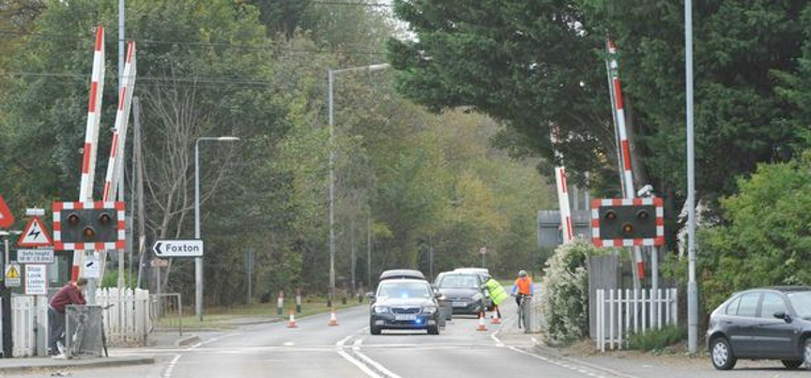
Level crossings
Notes:
As pedestrians we need to:
Concentrate – it’s easy to get distracted, especially by phones, music and conversation
Stop, Look, Listen and Think. Follow signs and instructions
Check both ways before crossing – if there is a train coming, do not cross
We must not cross until the barriers are fully raised – there may be more than one train.
Cross quickly, but do not run, holding hands with an adult
Some crossings are ‘open’ and don’t have barriers, some have a ‘full barrier’ which blocks the entire road, whilst others have a ‘half barrier.’
For more information visit: https://www.networkrail.co.uk/communities/safety-in-the-community/level-crossing-safety/pedestrian/

Slide 3
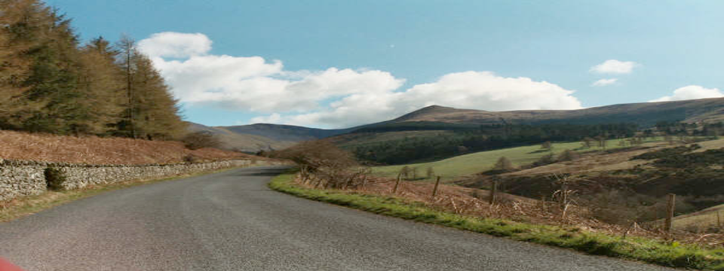
Rural roads
Notes:
The number of pedestrian accidents are higher in urban areas. However, the issue is no less serious in rural areas - rural roads are narrow and often have no pavement or crossings.
As a pedestrian, by walking in the direction of oncoming traffic (as recommended by the Highway Code) you are more likely to see the danger and take avoiding action by moving out of the way.
Always find a safe place to cross that is not on a bend/corner, so that you can see any vehicles coming from both directions
For more info visit: https://www.rospa.com/road-safety/advice/road-users/rural/

Slide 4
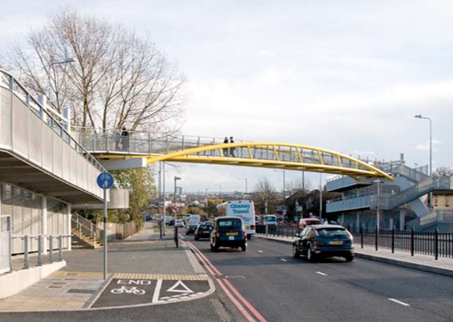
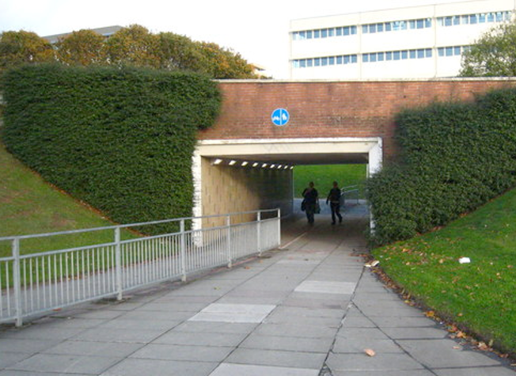
Footbridges & subways
Notes:
Footbridges go over roads and subways go under roads

Slide 5
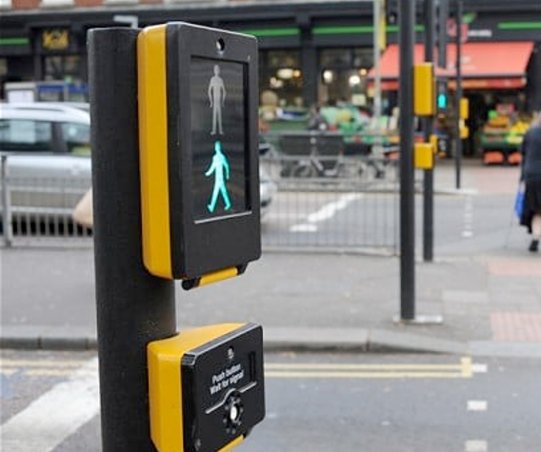
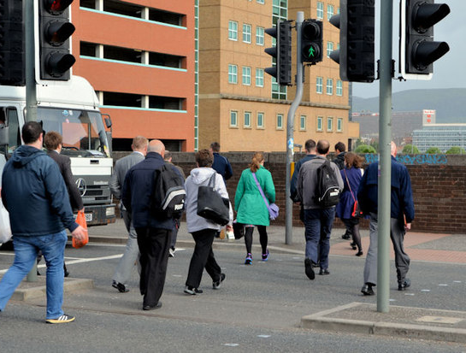
Safer places to cross
Puffin crossing
Notes:
Show children the range of safest places to cross the road, across the next 4 slides:
If you can, use: puffin crossings, toucan crossings, traffic islands, zebra crossings, footbridges and subways
Cross where you can see clearly in all directions
Avoid crossing between parked cars, because drivers will find it hard to see you, and you will find it hard to see moving vehicles
Show children how to Stop, Look, Listen, Think. You may want to play the film ‘Crossing roads: Kids know best’ on the THINK! education website

Slide 6
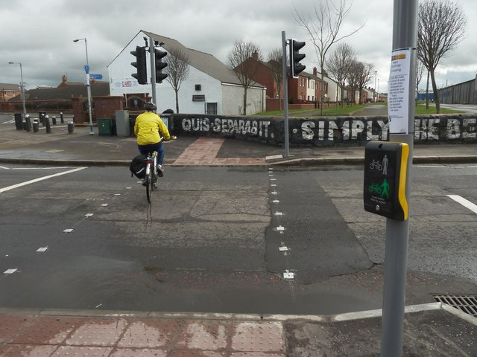
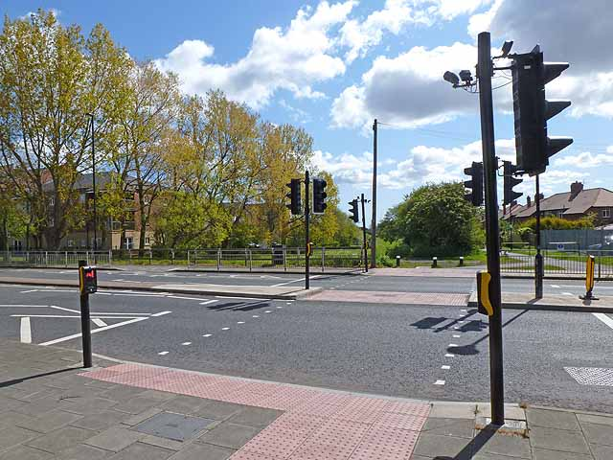
Safer places to cross
Toucan crossing
Notes:
Show children the range of safest places to cross the road, across the next 4 slides:
If you can, use: puffin crossings, toucan crossings, traffic islands, zebra crossings, footbridges and subways
Cross where you can see clearly in all directions
Avoid crossing between parked cars, because drivers will find it hard to see you, and you will find it hard to see moving vehicles
Show children how to Stop, Look, Listen, Think. You may want to play the film ‘Crossing roads: Kids know best’ on the THINK! education website

Slide 7
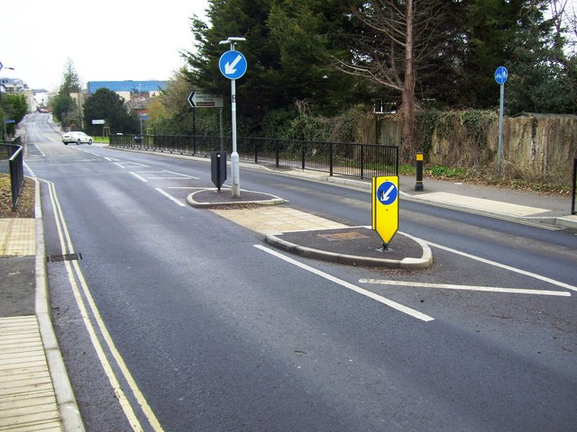
Safer places to cross
Traffic island
Notes:
Show children the range of safest places to cross the road, across the next 4 slides:
If you can, use: puffin crossings, toucan crossings, traffic islands, zebra crossings, footbridges and subways
Cross where you can see clearly in all directions
Avoid crossing between parked cars, because drivers will find it hard to see you, and you will find it hard to see moving vehicles
Show children how to Stop, Look, Listen, Think. You may want to play the film ‘Crossing roads: Kids know best’ on the THINK! education website

Slide 8
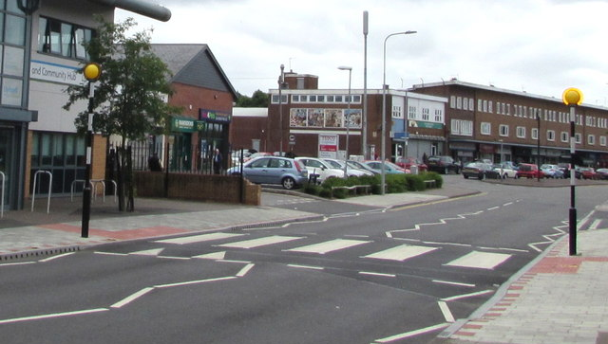
Safer places to cross
Zebra crossing
Notes:
Show children the range of safest places to cross the road, across the next 4 slides:
If you can, use: puffin crossings, toucan crossings, traffic islands, zebra crossings, footbridges and subways
Cross where you can see clearly in all directions
Avoid crossing between parked cars, because drivers will find it hard to see you, and you will find it hard to see moving vehicles
Show children how to Stop, Look, Listen, Think. You may want to play the film ‘Crossing roads: Kids know best’ on the THINK! education website

Slide 9
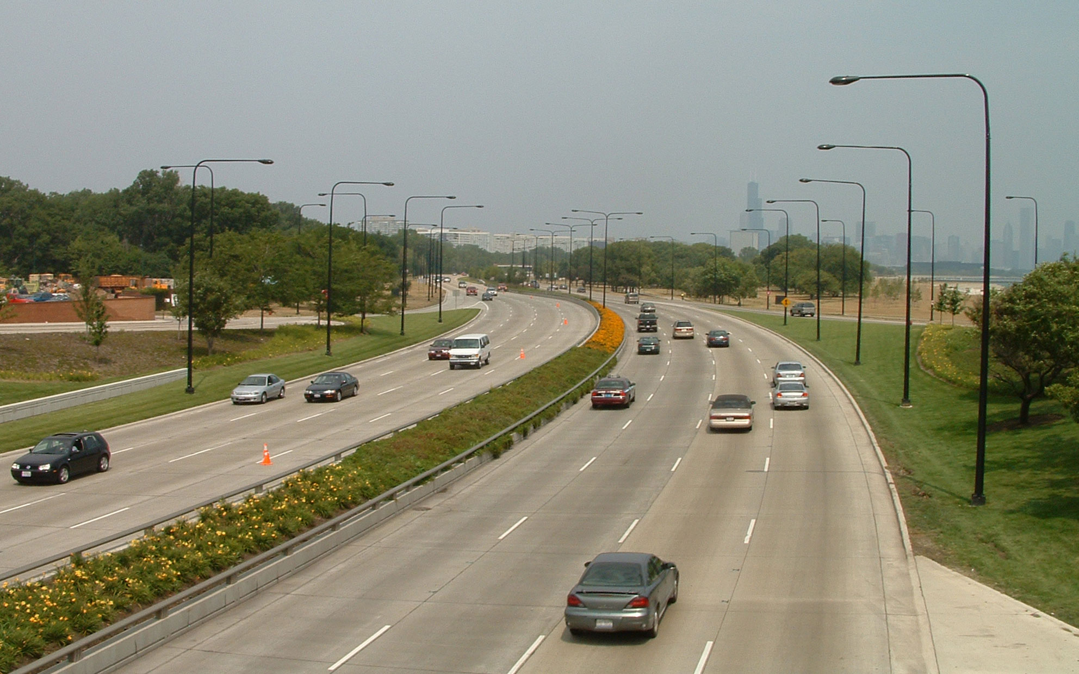
Other countries
Notes:
Teacher note: Where appropriate, remind children (especially before the holidays), that some other countries drive on the opposite side of the road. So be extra careful when abroad and continue to looking both left and right before crossing the road.

Slide 10
Stop
Look
Zebra crossing
Cars
Motorbike
Bin lorry
Bicycle
Pedestrians
Listen
Think
Buses
Traffic light
Pavement
Notes:
Use as part of Lesson ‘1. Stepping stones to road safety’ as the key word display

