Slide 1

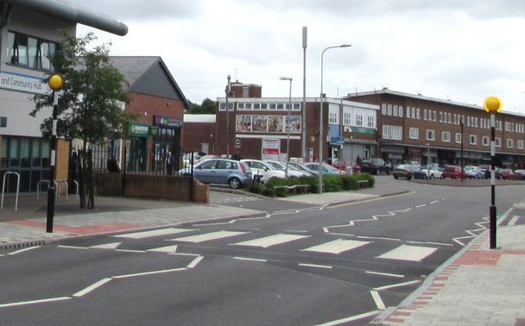
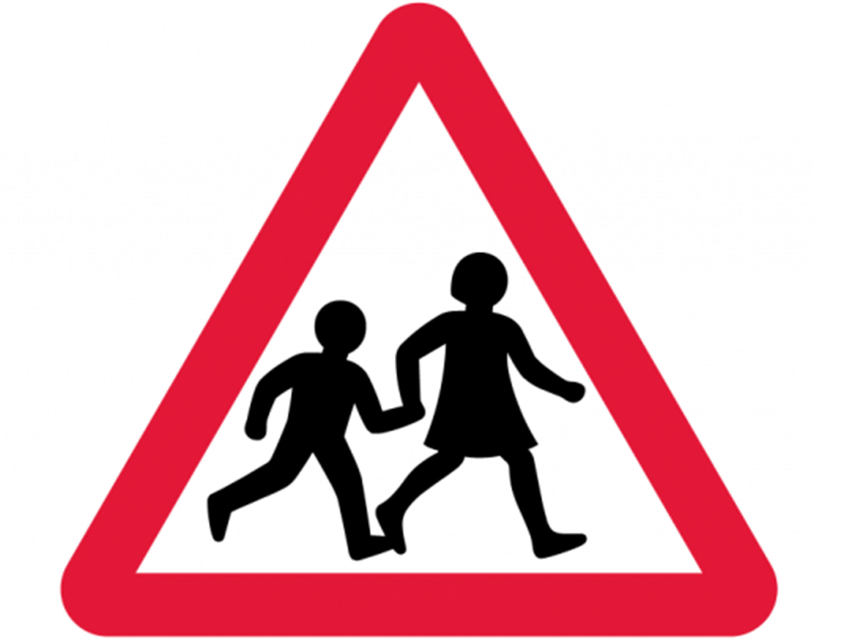
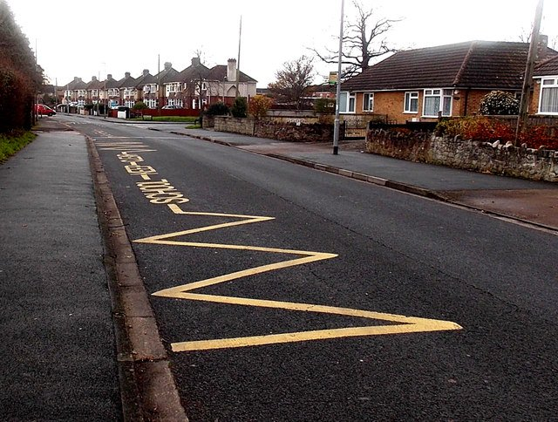
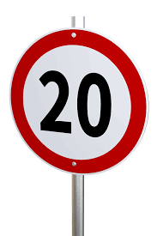
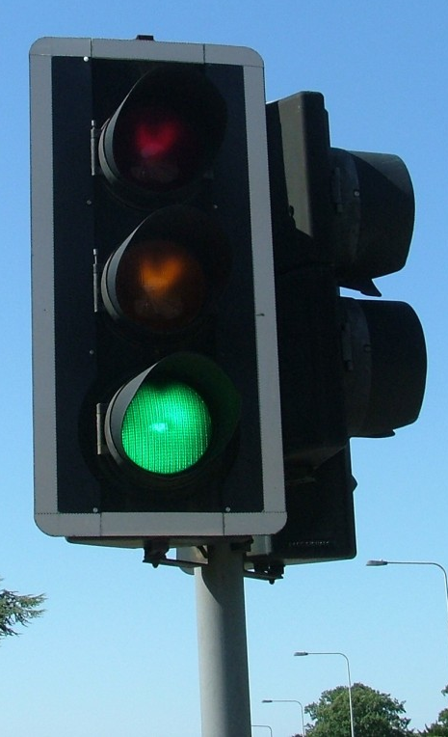

Road safety checklist
Notes:
Explain to children that they should tick each box when they see each item on their walk:
Zebra crossing
Traffic light
Yellow or white zig zag road markings – Cars or other vehicles are not allowed to park anywhere on these lines, to let young people nearby to see clearly left and right when crossing the road. These lines are often placed on roads around schools.
20 mph sign – These signs tell drivers to reduce their speed to less than 20 mph because there is likely to be young people on the pavements and crossing roads where this sign is shown. The lower speed helps drivers and pedestrians to be more aware of each other.
Children crossing sign - This sign indicates to drivers that they should watch for children crossing the road in this area.

Slide 2
Road safety checklist
Notes:
Note for teachers: To create your own road safety checklist for your school’s area, please drop your own images in place of the boxes. You may want to include features such as:
Zebra crossing
Traffic light
Yellow or white zig zag road markings
20 mph sign
Children crossing sign

