Slide 1
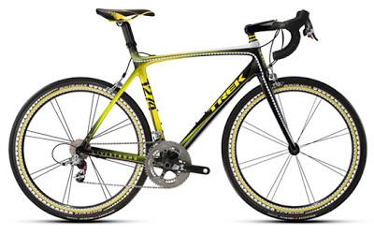
Why walk, scoot or cycle to school?

Slide 2
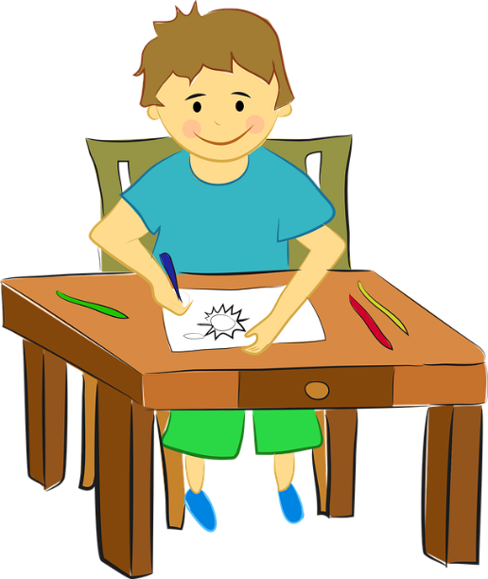
So, why……?
We all know that walking, cycling and scooting are good for us. Do you know why?*
It’s healthy for your body and mind
It’s good for the environment
It helps you learn
It keeps you safe
You learn about where you live
It teaches you independence
You get to spend time with family and friends
Notes:
*You could pause the assembly here to get pupils’ ideas on why walking and cycling to school are good.

Slide 3
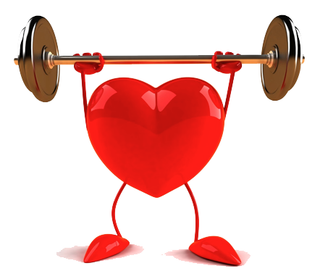
It keeps your body healthy
Do you think you get enough exercise?
How much physical exercise do you think you need every day to stay healthy? *
It’s actually 1 hour.
You can get that exercise by simple things like walking, cycling or scooting to places instead of going by car.
Physical activity can help keep you healthy by:
Burning fat
Lowering blood pressure
Building strong muscles and bones
Giving your heart a workout
This Photo by Unknown Author is licensed under CC BY-NC
Notes:
*You could discuss how much physical activity the children think they need each day. What estimates do the children have? In fact, it is 1 hour.

Slide 4
It keeps your mind healthy
Physical activity can also help your mental health
Helps you sleep better
Boosts your mood
Reduces stress and anxiety
Gives you more energy
Helps your self esteem

Slide 5
It’s good for the environment
If more people walk, cycle or scoot, then they don’t need to use cars
This means that there is less pollution and can help tackle climate change
Did you know that 1 in 4 cars on the roads in the morning are going to schools? That’s a lot of pollution and a lot of cars.
Cars produce harmful things such as carbon monoxide and nitrogen dioxide, which harm the environment and make it harder for people with health conditions to breathe.

Slide 6
It helps you learn
Regular physical exercise:
Helps you concentrate
Improves your memory
This Photo by Unknown Author is licensed under CC BY-NC

Slide 7
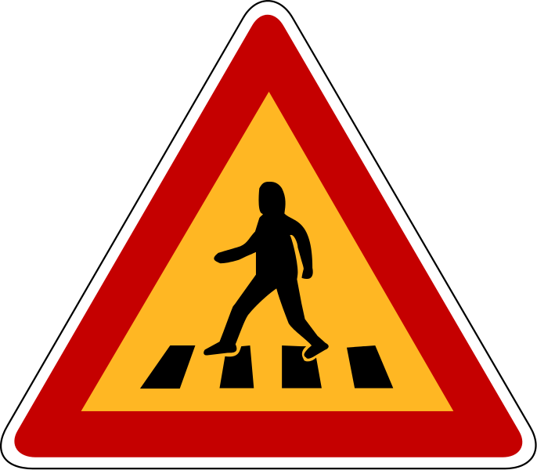
It helps you stay safe
You can learn road safety skills like:
Crossing roads
Coping with traffic
Navigation
This Photo by Unknown Author is licensed under CC BY-SA

Slide 8
You can learn about where you live
Find
You can find different routes that you would not know if you travelled everywhere by car
Learn
You can learn navigation skills by learning simple things like the way from your house to school.
Meet
You can meet your neighbours.
Who do you see on your journey to school?
See
You can see what buildings and wildlife are in your area
What is special about where you live?
Notes:
Ask pupils to discuss who and what they see on their journey to school. Why is that important?

Slide 9
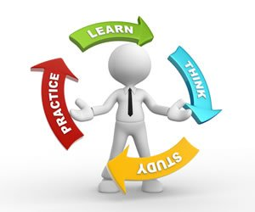
Other benefits
Walking and cycling teach you independence so that you can choose to walk, cycle or scoot when you are able to make your own travel choices.
You can spend time with family or friends when walking, cycling or scooting to school
This is a great time to talk with them and make good relationships.
This Photo by Unknown Author is licensed under CC BY-NC-ND

Slide 10
This Photo by Unknown Author is licensed under CC BY-ND

Slide 11
Discussion
Why are walking, cycling and scooting good?
How much physical activity do you need per day?
How much physical activity do you get per day?
What skills can you learn when you walk, cycle or scoot?
If you can’t walk, cycle or scoot to school from home, how might you still be able to get the amount of exercise you need?
This Photo by Unknown Author is licensed under CC BY
Notes:
You could use these questions as a basis for discussing the benefits of walking, cycling or scooting.

